Slide 1
Nari – Women Safety
PID: 593
Dhananjay Navani
CBA14

Slide 2
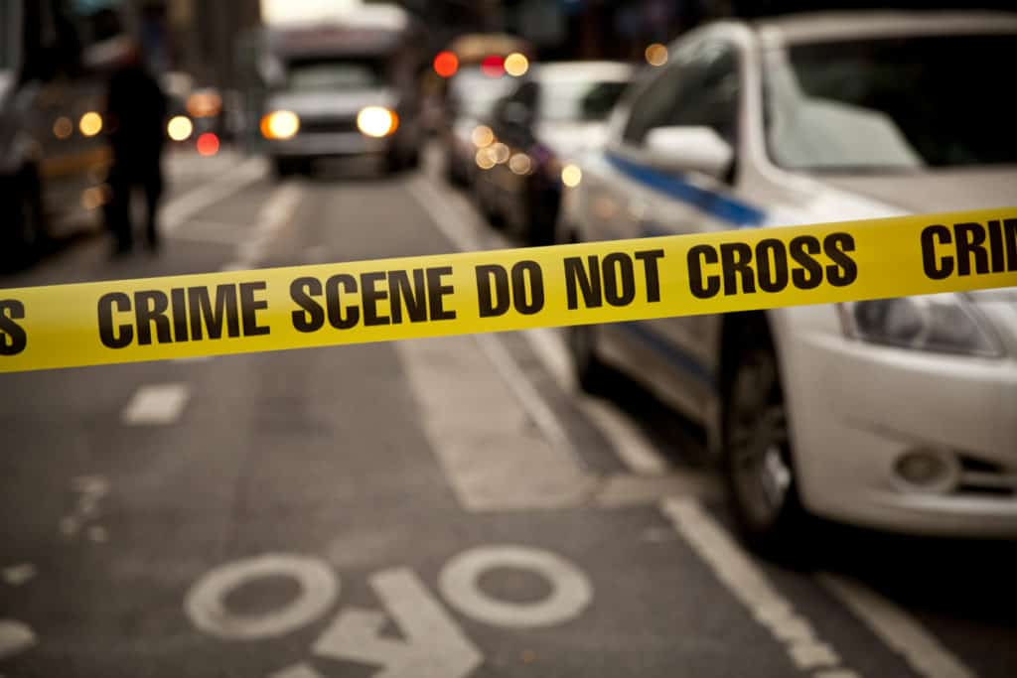
Intorduction
In today's world, as we all see the crime which is happening to most women, 85 of 100 crimes are happening to women.We all know that most of the women are now working and as some of them have to travel late night, their safety is must. So just like it is important to know self-defense, it is also important provide women their safety applications.

Slide 3

There are many problems we all know, like most of the women are working in night shifts their safety is the most important, as most of the ladies travel at late night. So, it's necessary to remain alert and safe.

Slide 4
Nowadays, most of the people carry their smartphones and it is a boon for them. Hence it is necessary to have at least one personal safety application installed. And here we come with a solution namely: NARI - WOMEN SAFETY APPLICATION.
This application provides a sense of security to it's users and it's totally free of cost, so that it can reach to every woman who's working late for her son or daughter or to make a good and peacful living, and she can freely go out without thinking twice about her safety.

Slide 5


Slide 6

Features In Applications
This application provides a sense of security to it's users and it's totally free of cost, so that it can reach to every woman who's working late for her son or daughter or to make a good and peacful living, and she can freely go out without thinking twice about her safety.

Slide 7
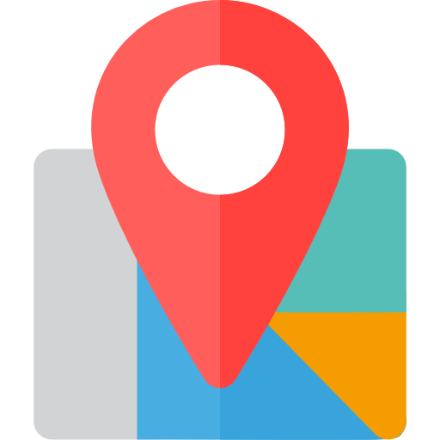
Tracking Location
The second feature is about tracking the location of the users for their own safety purpose. While tracking the location, we can even send the message to the guardians whether we are reaching the destination or not. We have implemented this feature with the help of the Geofence Library.

Slide 8

Fake Call
There is also a fake call feature in it where the user gets a fake call screen on his/her smartphone and can escape any situation by making a false excuse.

Slide 9

Safe Zones
The Safe/Unsafe feature is used to see the nearby locations and check whether they are safe or unsafe for that time. Here, we are planning to make this feature more efficient by also taking the data of severalcrimes occurring in a particular area and then defining it as safe or unsafe for thattime. It will be in our future versions of the application.

Slide 10
Thank You

